Slide 1
Power and Politics

Slide 2
Power
The rational model of organizations considers effectiveness and behavior as being driven by objective, measureable, and formal processes
The political model of organizations recognizes that effectiveness and organizational behavior
is driven by people with competing interests who are using informal social processes to achieve goals
LECTURE 11: Power ∙ Politics ∙ Political Skill ∙ Managing

Slide 3
Power
Power is a measure of person’s ability to influence the attitudes and behaviors of other individuals; it is based in a dyadic (two-person) relationship
Influence is the actual process of affecting attitudes or behaviors
LECTURE 11: Power ∙ Politics ∙ Political Skill ∙ Managing

Slide 4
Power
Managers in organizations typically have authority, which is the formal right to influence a subordinate
Authority only influences subordinate behavior if the request falls in the zone of indifference (i.e., it is perceived as legitimate)
LECTURE 11: Power ∙ Politics ∙ Political Skill ∙ Managing

Slide 5
Bases of Power
There are five forms of interpersonal power used in organizations:
Reward power is based on an influencer’s control over rewards desired by a target; employee must see a clear and strong link to the reward
Coercive power is based on an influencer’s control over punishments; target must believe conformity will avoid punishment
LECTURE 11: Power ∙ Politics ∙ Political Skill ∙ Managing

Slide 6
Bases of Power
Legitimate power is based on position and mutual agreement that an influencer can affect/dictate the behavior of a target; narrow range that is specifically defined
Expert power is based on the perception of an influencer’s knowledge and effectiveness in a particular domain; such expertise must be important to target -
resides in the individual
LECTURE 11: Power ∙ Politics ∙ Political Skill ∙ Managing

Slide 7
Bases of Power
Referent power is based on interpersonal attraction and feelings of identity with an influencer; targets will seek to behave and perceive in similar ways to influencers and may not realize the existence of referent power – charisma is in a form of referent power – resides in the individual
Information power is based on access to and control over the presentation of useful information; actor’s framing of information can influence/bias recipient’s interpretation
LECTURE 11: Power ∙ Politics ∙ Political Skill ∙ Managing

Slide 8
ACTIVITY
LECTURE 11: Power ∙ Politics ∙ Political Skill ∙ Managing

Slide 9
Bases of Power
Reward, coercive, and legitimate power tend to result in: Compliance
Referent power tends to result in:
Organizational effectiveness, internal change - commitment
Expert power tends to result in:
Optimal Performance, staisfaction, learning
LECTURES 11: Power ∙ Politics ∙ Political Skill ∙ Managing

Slide 10
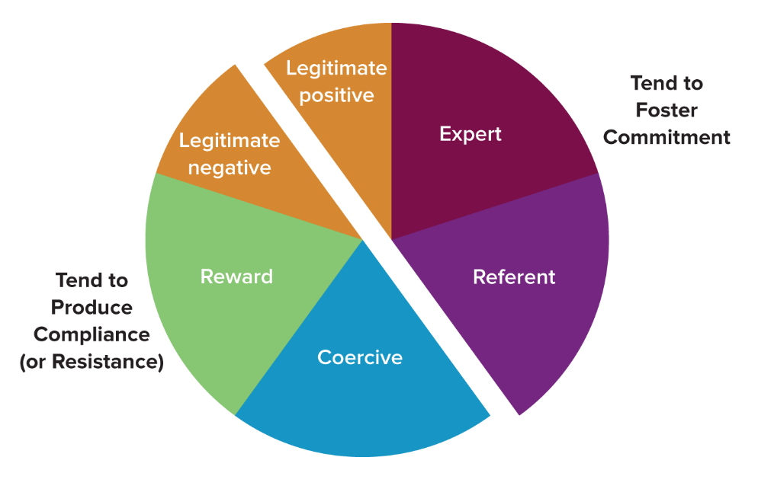
Bases of Power
LECTURES 11: Power ∙ Politics ∙ Political Skill ∙ Managing

Slide 11
Dependence
“Power is a property of the social relation, not the actor” -R. M. Emerson (1962)
Power is:
+ Positively related to a target’s motivational investment in goals over which an influencer controls fulfillment (e.g., pay, knowledge, self-esteem, belongingness, etc.)
– Negatively related to the availability of goal fulfillment outside of the target-influencer relationship
LECTURE 11: Power ∙ Politics ∙ Political Skill ∙ Managing

Slide 12
Dependence
When power relations are imbalanced favoring the influencer, the target may resist and engage in one of two modes:
  Cost reduction, where the target makes it easier for him/herself to conform to the influencer (typically by changing their values on relevant entities)
  Balancing operations, the target seeks to reduce dependence on the influencer (e.g., disengage from the goal, find alternatives, coalitions, etc.)
LECTURE 11: Power ∙ Politics ∙ Political Skill ∙ Managing

Slide 13
Power and Ethics
Power can be used ethically when influencers are sensitive to employees’ concerns and communicate well
Power-related behavior is ethical if it:
Benefits people inside and outside the firm
Respects the rights of all parties
Treats all parties equitably and fairly
LECTURE 11: Power ∙ Politics ∙ Political Skill ∙ Managing

Slide 14
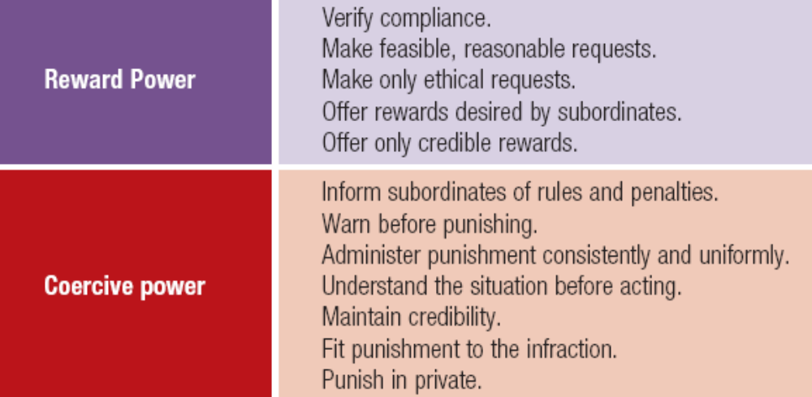
Power and Ethics
LECTURE 11: Power ∙ Politics ∙ Political Skill ∙ Managing

Slide 15
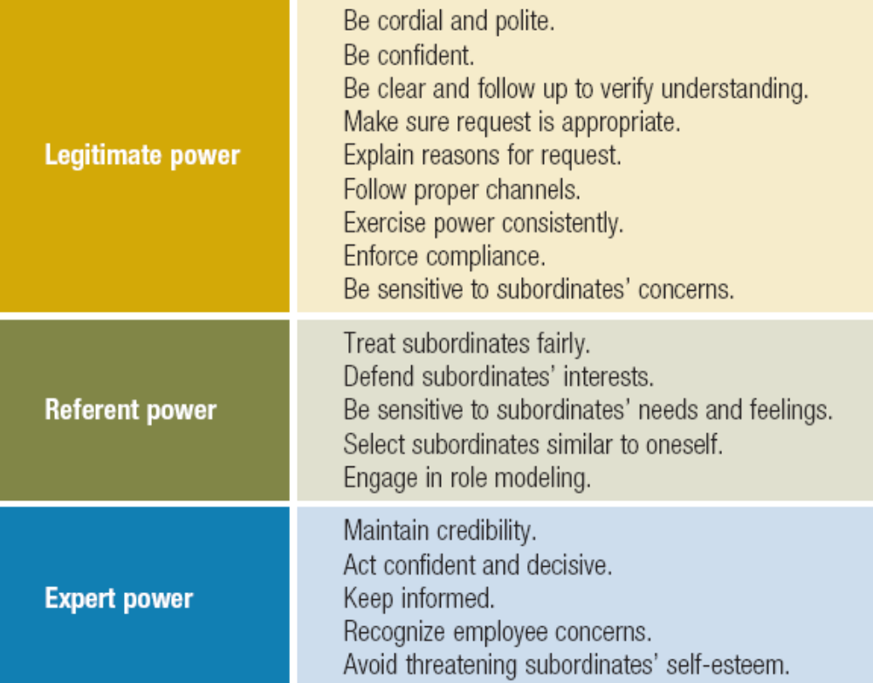
Power and Ethics
LECTURE 11: Power ∙ Politics ∙ Political Skill ∙ Managing

Slide 16
Power
Please review the “Power Sharing and Empowerment” section on your own
LECTURE 11: Power ∙ Politics ∙ Political Skill ∙ Managing

Slide 17
Organizational Politics
Organizational politics is the use of power and social influence to obtain desired outcomes in organizations
The “rules” of politics in any organization are informal (they arise organically), often unspoken, and learned either through indirect/vicarious experience or directly from those with political power
LECTURE 11: Power ∙ Politics ∙ Political Skill ∙ Managing

Slide 18
Political Behavior
Political behavior is any action not sanctioned by the organization that is taken to influence others in order to meet one’s personal goals
Political behavior can be:
Defensive (reactive) or assertive (proactive)
Tactical (short-term) or strategic (long-term) mostly reputation building
LECTURE 11: Power ∙ Politics ∙ Political Skill ∙ Managing

Slide 19
Political Behavior
Political behavior typically consists of either:
  Influence tactics, which are a direct means of influencing other, by altering their behavior and thoughts, and gaining power
  Impression management tactics, which are an indirect means of influencing others and gaining power by creating a desired image of oneself in the minds of others, which then alters their behavior
LECTURE 11: Power ∙ Politics ∙ Political Skill ∙ Managing

Slide 20
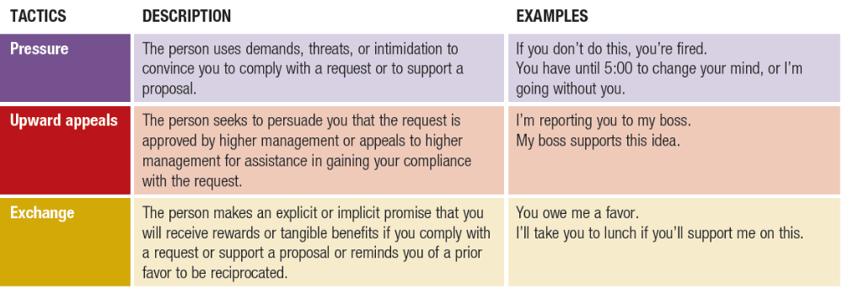
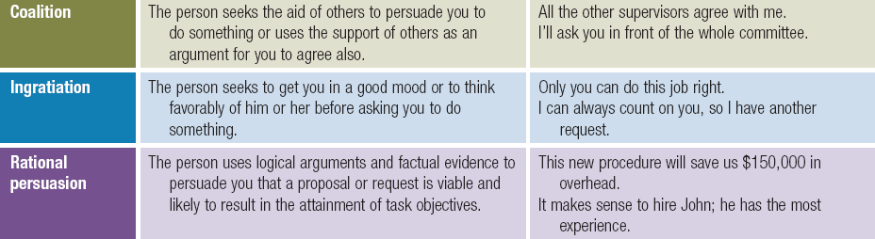
Political Behavior
Influence behaviors include:
LECTURE 11: Power ∙ Politics ∙ Political Skill ∙ Managing

Slide 21
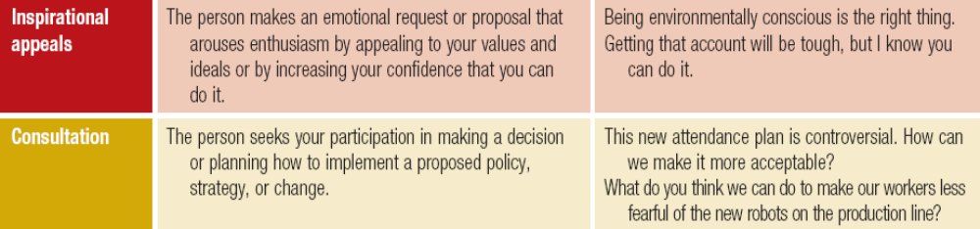
Political Behavior
The most common reasons for tactic usage on:
Subordinates: change behavior, assign tasks
Peers: request help
Superiors: request approval or resources, obtain personal benefits
LECTURE 11: Power ∙ Politics ∙ Political Skill ∙ Managing

Slide 22
Political Behavior
The most effective influence tactics for each outcome are:
Commitment to a task: inspirational appeal, consultation, rational persuasion
Compliance: exchange, ingratiation
Resistance: Pressure, upward appeal, coalition
LECTURE 11: Power ∙ Politics ∙ Political Skill ∙ Managing

Slide 23
Political Behavior
Impression management tactics each elicit a specific appearance or image:
  Ingratiation: appear likeable, attractive most effective
  Self-promotion: appear competent, expert
Exemplification: appear loyal, conscientious, dependable, reliable most effective
  Intimidation: appear aggressive, powerful, dangerous
  Supplication: appear weak, compliant
LECTURE 11: Power ∙ Politics ∙ Political Skill ∙ Managing

Slide 24
Political Behavior
The key to successful influence or impression management is to appear sincere and genuine in one’s actions or requests
Influence targets will be more likely to suspect ulterior or self-interested motives when the influence/impression behavior is not consistent with social norms or not appropriate for the goal
LECTURE 11: Power ∙ Politics ∙ Political Skill ∙ Managing

Slide 25
ACTIVITY
LECTURE 11: Power ∙ Politics ∙ Political Skill ∙ Managing

Slide 26
Political Behavior
Successful political behavior (influence tactics, impression management) is linked to many positive outcomes for the individual engaging in it, such as:
Higher performance evaluation ratings
Higher pay
Greater assessments of promotability
Heightened overall career success
Improved leader-follower relations
LECTURE 11: Power ∙ Politics ∙ Political Skill ∙ Managing

Slide 27
Political Behavior
The arising of politics depends on three situational characteristics that affect an employee’s work:
  Ambiguity in work processes and procedures enhances politics: e.g., low formalization, low centralization, minimal feedback, etc.
  Norms that produce large and rigid power differentials enhance politics: e.g., authoritarian leadership, normative formal power usage, etc.
  High frequency of social interactions can enhance politics; e.g., personal accountability becomes salient
LECTURE 11: Power ∙ Politics ∙ Political Skill ∙ Managing
Notes:
Ambiguity leaves space for people to act informally to resolve that ambiguity, because people dislike ambiguity; those who resolve ambiguity are often perceived as more powerful by others
Large and rigid power differentials remove scrutiny from those in power, which both enhances the amount of social influence behavior they engage in (and model for others), but also encourages people to see social influence as the only means of climbing the rigid hierarchy
Social interaction can heighten the salience of social expectations and the salience of the utility of others in achieving one’s goals

Slide 28
Perception of Politics
Political behavior shapes the political context, expectations, and assumptions experienced by employees people often view politics can be useful and beneficial for organization, but politics as negative or toxic
The perception of politics (POPS) is the degree to which people attribute other people’s behavior to self-interested motives (i.e., poorly executed political behavior), or perceive their organization’s formal processes to be biased by social influence
LECTURE 11: Power ∙ Politics ∙ Political Skill ∙ Managing

Slide 29
Perception of Politics
Although political behavior may be beneficial for the actor, when it is perceived as self-serving (i.e., the more POPS arises among others) by others, there are negative consequences for those others:
Increased stress, and intention to turnover
Decreased satisfaction, commitment, and performance
Increased likelihood of others engaging in political
behavior themselves
Decreased perceptions of justice/fairness
LECTURE 11: Power ∙ Politics ∙ Political Skill ∙ Managing

Slide 30
Political Skill
Political skill is the ability effectively understand others at work, and to use such knowledge to influence others to act in ways that enhance one’s personal and/or organizational objective
Political skill has been found to enhance the
social and organizational effectiveness of employees and leaders
LECTURE 11: Power ∙ Politics ∙ Political Skill ∙ Managing

Slide 31
Political Skill
Political skill consists of four dimensions:
  Social astuteness: Understanding of social dynamics, self-awareness
  Interpersonal influence: Adapting one’s behavior to meet situational demands and elicit desired responses in others
  Networking ability: Develop social relations and alliances, obtain resources
  Apparent sincerity: Appear authentic only works if others buy it
LECTURE 11: Power ∙ Politics ∙ Political Skill ∙ Managing

Slide 32
Political Skill
LECTURE 11: Power ∙ Politics ∙ Political Skill ∙ Managing

Slide 33
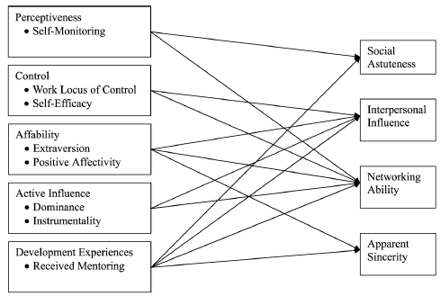
Political Skill
Political Skill is rooted in various traits (Ferris, Blickle et al., 2008)
One of biggest predictors
LECTURE 11: Power ∙ Politics ∙ Political Skill ∙ Managing

Slide 34
Political Skill
Political skill can serve many functions for an individual, including:
  Neutralize stressors (e.g., role conflict, role overload, supervisor conflict, POPS for oneself)
  Increases effectiveness of political behavior (e.g., enhance likelihood of desired outcome, reduce the likelihood that they will be perceived as solely self-serving)
  Enhancing work outcomes (e.g. job performance, leader effectiveness, trust)
LECTURE 11: Power ∙ Politics ∙ Political Skill ∙ Managing

Slide 35
Managing Politics
Political behavior is unavoidable and it is not necessarily a bad thing
Leaders often use influence and impression management tactics to:
Enhance cooperation
Create consensus in how things are perceived
Clarify and inspire goal-directed team performance
LECTURE 11: Power ∙ Politics ∙ Political Skill ∙ Managing

Slide 36
Managing Politics
There are two employee experiences that can help reduce the negative effects of POPS:
  Understanding the causes, expectations, norms, and general nature of politics in one’s context
  Having a sense of control over the arising and enactment of politics in one’s context
This can be done situationally (e.g., leadership or management actions, organizational processes, etc.), or by enhancing employees’ political skill
LECTURE 11: Power ∙ Politics ∙ Political Skill ∙ Managing

Slide 37
*** test Managing Politics
The other primary approach is to reduce the likelihood of political behavior and POPS arising in the first place, some tactics include:
Transparent communication and feedback (reduces uncertainty)
Managing and clarifying resource allocation
Participative management and involvement (neutralizes threat in felt accountability)
Encouraging cooperation among groups
Managing scarce resources equitably
LECTURE 11: Power ∙ Politics ∙ Political Skill ∙ Managing

